Slide 1
NBA Analysis and Prediction
By Ashwin Satish and Joseph Russell

Slide 2
Project Overview
Based on the NBA (National Basketball Association)
Create visualizations & interpretations based on the past 5 seasons
Objective: Build a model to predict game outcomes
Data: Player, team, and game statistics from 2020 - 2024

Slide 3
Dataset & References
The datasets (2020-2024) leveraged are
Player data
Basic statistics for players
Points, minutes played, etc.
Advanced statistics
Win Shares, PER, etc.
Team data
Statistics (offensive and defensive) for teams
Average points, rebounds, assists, etc. per game
Games
All NBA games (teams involved, date, final scores)
Scraped list of players who played in each game
Data scraped from https://www.basketball-reference.com/

Slide 4
Tech stack used
Python
Visualizations
Matplot
Plotly
Seaborn
Machine Learning
SciKit-Learn
Data Manipulation
Pandas
Numpy

Slide 5
K-means clustering
The process we followed
Dimensionality reduction
simplifies data by focusing on the most important information while removing unnecessary details.
It helps make big datasets easier to analyze without losing the overall meaning
We utilized PCA
A technique that reduces the number of features in a dataset by combining them into a smaller groups of key components while keeping most of the important information.
It helps simplify data for analysis and visualization

Slide 6
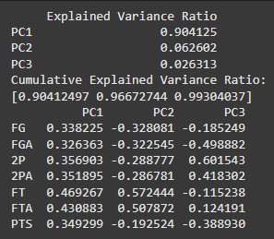
K-means clustering
PC1 (component 1) explains 90.4% of the variance (captures most info in the data)
PC2 (component 2) adds 6.3%, bringing the cumulative variance to 96.7%.
PC3 (component 3) contributes an additional 2.6%, for a total of 99.3%.

Slide 7
K-means clustering
Determining clusters
We utilized the elbow method
A method to decide how many groups/clusters are best for your data.
Works by making a graph that shows how well the data clusters as you increase the number of clusters.
(sudden drop in inertia for any k = better clusters)
At first, adding more clusters makes things much better, but after a certain point, the improvement slows down and looks like a bend in your elbow on the graph.
The "elbow" is where we stop and pick the number of clusters.

Slide 8
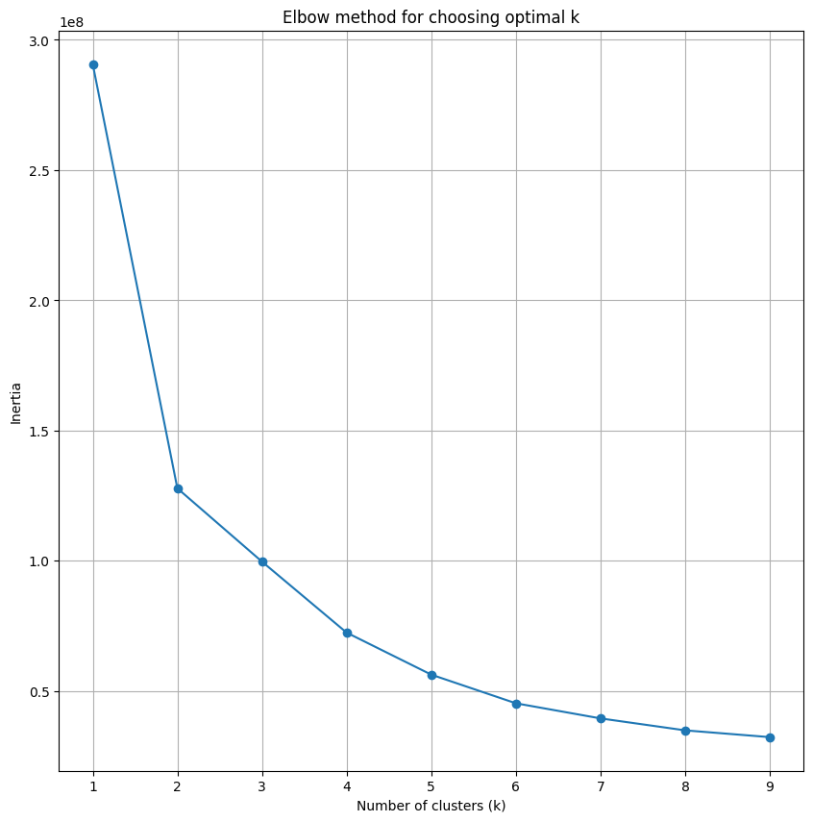
K-means clustering

Slide 9
K-means clustering
We utilized the silhouette score method to verify k values.
The score checks how well data points are grouped. It compares how close a point is to its own cluster versus other clusters. Scores range from -1 to 1:
Higher scores mean better-defined clusters, while lower scores suggest the need for improvement.

Slide 10
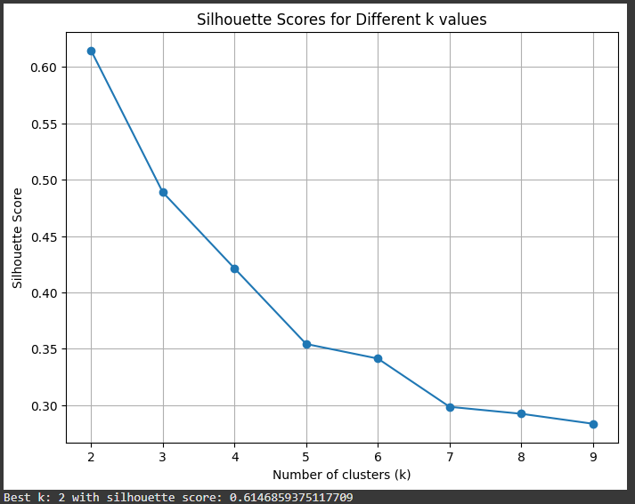
K-means clustering

Slide 11
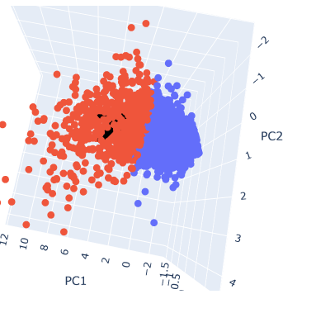
K-means clustering

Slide 12
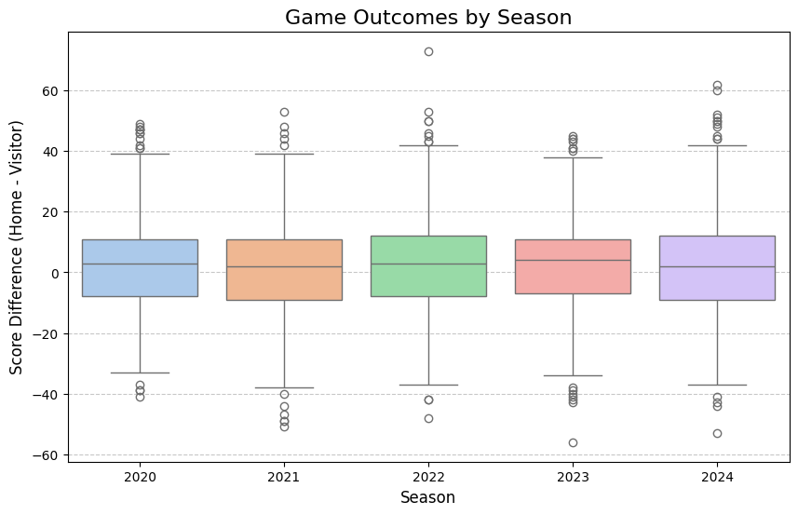
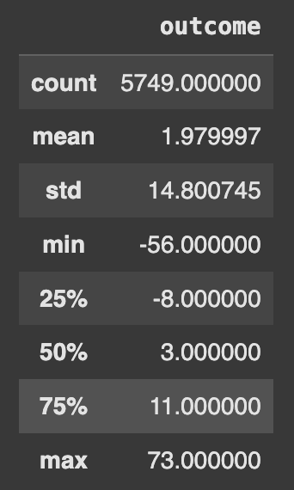
Game Outcomes

Slide 13
Modeling Approach
Baseline: Linear Regression with team data
Input only includes season statistics for each team
MSE: ~180
Second iteration: Player data
Scraped box scores to determine which players played in each game
Accounts for injuries, trades, etc.

Slide 14
Final Model
Lasso Regression
Least absolute shrinkage and selection operator
L1 Regularization - reduces model complexity and prevents overfitting
Input included 6 statistics for all 10 starters
WS, PER, TS%, 3P%, BPM, PTS
Cross Validation MSE - ~170

Slide 15
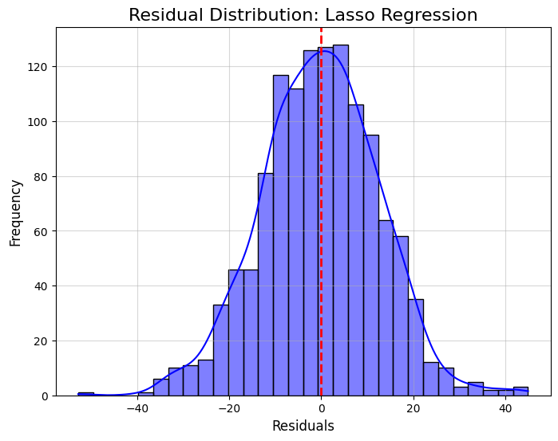
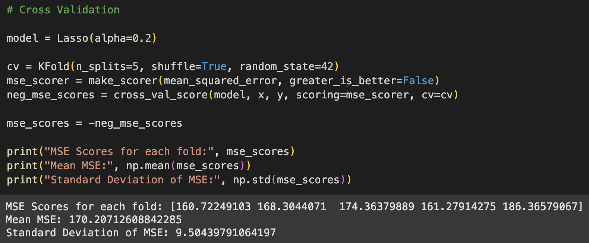
Model Performance

Slide 16
Conclusion
Basketball games involve a lot of randomness
Team performance varies and models can’t account for everything
Ideas for improvement:
Include more seasons
Time-series model (ARIMA or SARIMA)
Applications:
Choosing players to draft or trade for
Negotiating contracts

Slide 17
Challenges & Resolutions
Model & datasets were not appropriate for clustering.
Basketball is an unpredictable sport
Worked on feature engineering to distinguish players better.
Principal components were not retaining data.
Changed standardization approach from StandardScaler to RobustScaler.
Went from 70% retention with 3 components to ~96%.

Slide 18
Thank you

